Slide 1
Artificial Intelligence
18BTCS504
Prof. Suresh Kapare

Slide 2
Different Types of Artificial Intelligence
Modeling exactly how humans actually think
cognitive models of human reasoning
Modeling exactly how humans actually act
models of human behavior (what they do, not how they think)
Modeling how ideal agents “should think”
models of “rational” thought (formal logic)
note: humans are often not rational!
Modeling how ideal agents “should act”
rational actions but not necessarily formal rational reasoning
i.e., more of a black-box/engineering approach
Modern AI focuses on the last definition
we will also focus on this “engineering” approach
success is judged by how well the agent performs
-- modern methods are also inspired by cognitive & neuroscience (how people think).

Slide 3
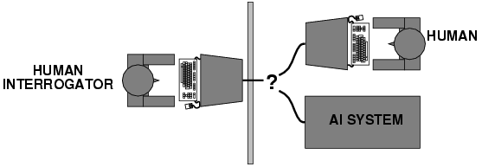
Acting humanly: Turing Test
Turing (1950) "Computing machinery and intelligence":
"Can machines think?" → "Can machines behave intelligently?"
Operational test for intelligent behavior: the Imitation Game
Suggested major components of AI:
- knowledge representation
- reasoning,
- language/image understanding,
- learning

Slide 4
Academic Disciplines important to AI.
Philosophy Logic, methods of reasoning, mind as physical system, foundations of learning, language, rationality.
Mathematics Formal representation and proof, algorithms, computation, (un)decidability, (in)tractability, probability.
Economics utility, decision theory, rational economic agents
Neuroscience neurons as information processing units.
Psychology/ how do people behave, perceive, process Cognitive Science information, represent knowledge.
Computer building fast computers engineering
Control theory design systems that maximize an objective function over time
Linguistics knowledge representation, grammar

Slide 5
History of AI
1943 McCulloch & Pitts: Boolean circuit model of brain
1950 Turing's "Computing Machinery and Intelligence"
1956 Dartmouth meeting: "Artificial Intelligence" adopted
1950s Early AI programs, including Samuel's checkers program, Newell & Simon’s Logic Theorist, Gelernter's Geometry Engine
1965 Robinson's complete algorithm for logical reasoning
1966—73 AI discovers computational complexity Neural network research almost disappears
1969—79 Early development of knowledge-based systems
1980-- AI becomes an industry
1986-- Neural networks return to popularity
1987-- AI becomes a science
1995-- The emergence of intelligent agents

Slide 6
Understand Computer……

